Slide 1

Primary Manufacturing Processes
    Casting
    Forming
    Welding
    Rapid Prototyping
Secondary Manufacturing Processes
    Machining and Grinding
    Coatings

Slide 2
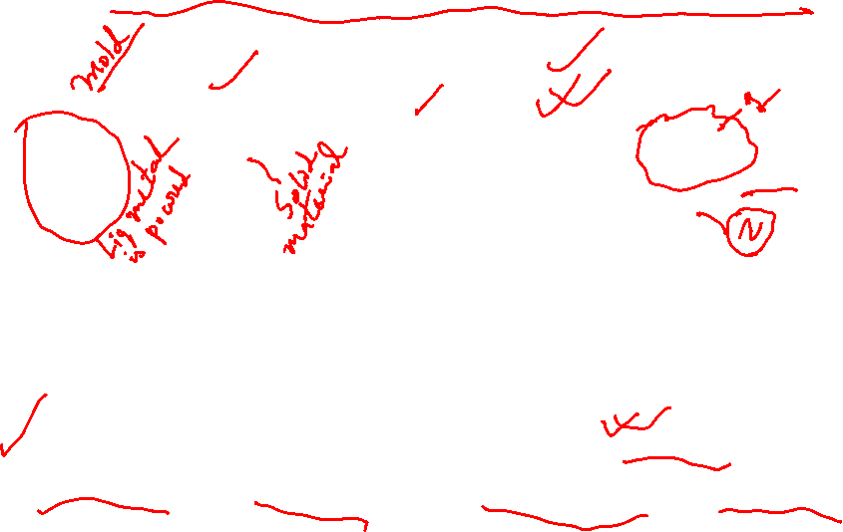
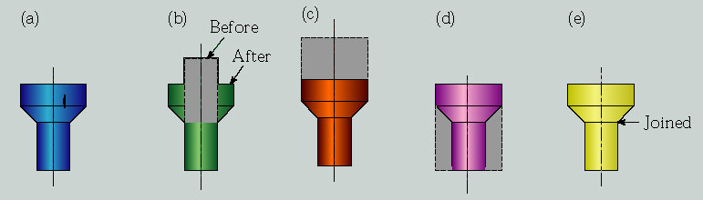
Production Methods for a Simple Part
Various methods of making a simple part:
(a) casting or powder metallurgy, (b) forging or upsetting, (c) extrusion, (d) machining, (e) joining two pieces.

Slide 3
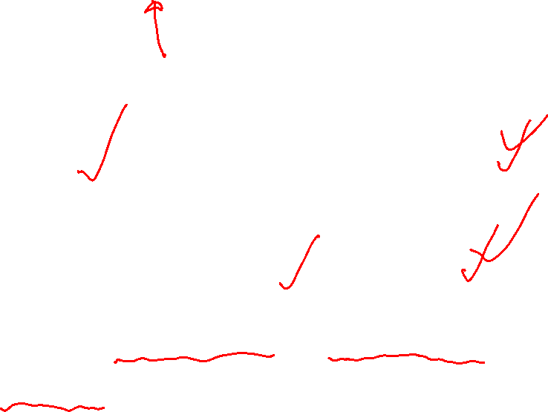
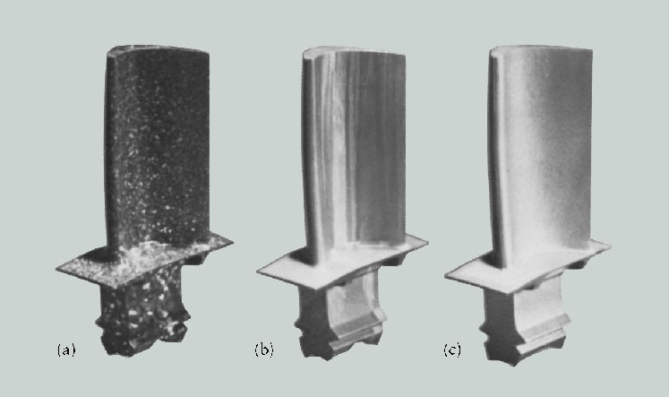
Turbine Blades for Jet Engines
Turbine blades for jet engines, manufactured by three different methods: (a) conventionally cast; (b) directionally solidified, with columnar grains, as can be seen from the vertical streaks; and (c) single crystal. Although more expensive, single crystal blades have properties at high temperatures that are superior to those to those of other blades. Source: Courtesy of United Technology Pratt and Whitney.

Slide 4

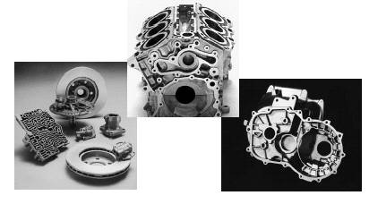
Casting Process
Cast products
Advantages
any intricate shape can be cast
any ferrous or non ferrous metals & alloys are castable
Tools required for casting molds are simple & inexpensive
Limitations
surface finish and dimensional accuracy is less in sand
casting process

Slide 5
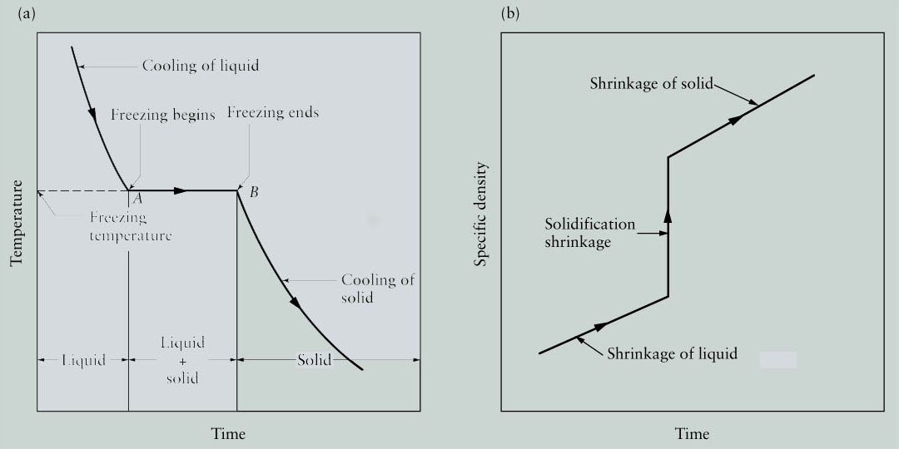

Solidification of Pure Metals
Solidification of Pure Metals
(a) Temperature as a function of time for the solidification of pure metals. Note that freezing takes place at a constant temperature. (b) Density as a function of time.

Slide 6

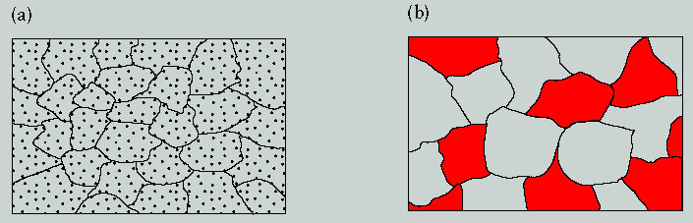
Grains of a Two-Phase System
(a) Schematic illustration of grains, grain boundaries, and particles dispersed throughout the structure of a two-phase system, such as lead-copper alloy. The grains represent lead in a solid solution of copper, and the particles are lead as a second phase. (b) Schematic illustration of a two-phase system consisting of two sets of grains: dark and light. Dark and light grains have their own compositions and properties, respectively.

Slide 7

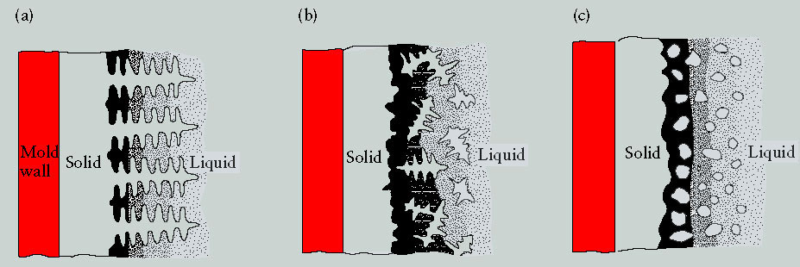
Basic Types of Cast Structures
Illustration of three basic types of cast structures: (a) columnar dendritic; (b) equiaxed dendritic; and (c) equiaxed nondendritic.

Slide 8
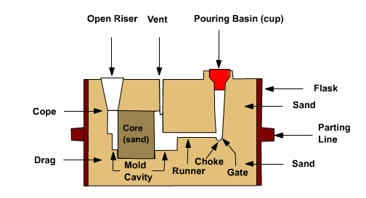
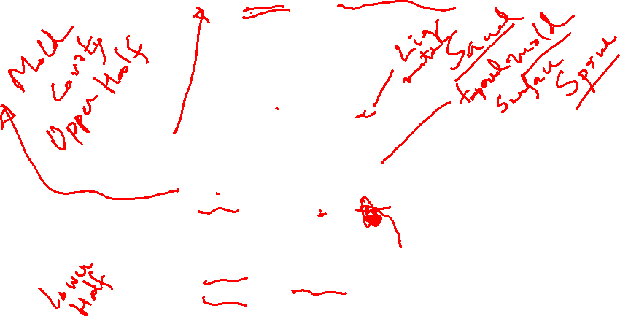
Schematic view of the Mold section showing some
casting terms

Slide 9

Steps in making Sand Casting
Pattern making
Core making
Molding
Melting and pouring
Cleaning of the cast products
Pattern
It is the replica of the object to be made by the casting process,
with some modifications.
Functions of the Pattern
1. A pattern is used to make a mold cavity
2. A pattern may contain projections known as core
prints if the casting needs to be made hollow.
3. Runner, gates, and risers used for feeding molten
metal in the mold cavity may be a part of the pattern.
4. Proper patterns with good surface finish reduce casting
defects.
5. A properly constructed pattern minimizes the overall cost

Slide 10
Pattern Material
A pattern may be made up of wood, plastic, rubber,
wax etc. The imp. Properties which the pattern matl.
must possess are:
light in weight
strong, hard and durable
resistant to wear and corrosion
dimensionally stable(unaffected by temp.,humidity)
Different types of patterns available
solid pattern
split pattern
match plate pattern
cope and drag pattern
sweep pattern
skeleton pattern

Slide 11
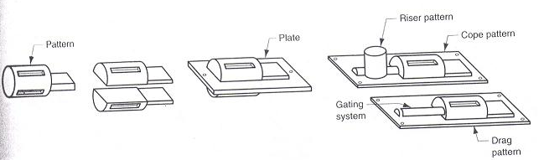
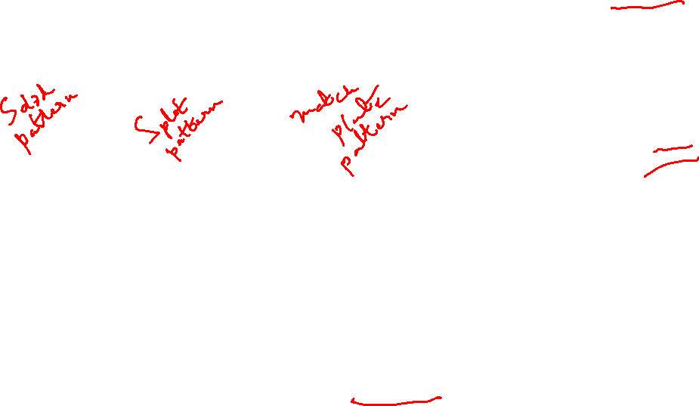
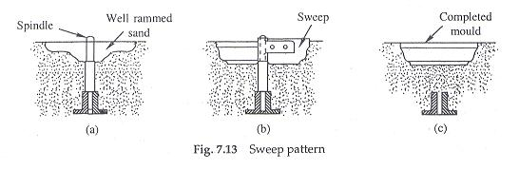
Schematics of Different Patterns

Slide 12
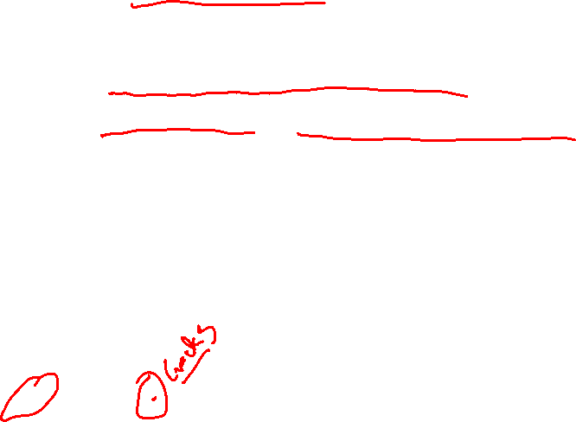
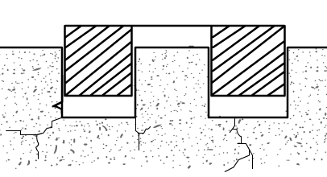
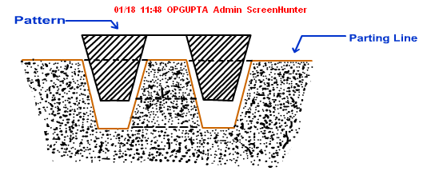
Pattern allowances
1. Shrinkage or contraction allowance
2. Draft or taper allowance
3. Machining or finish allowance
4. Distortion or camber allowance
5. Rapping allowance
Draft / Taper allowance

Slide 13

Shrinkage Allowance
Liquid shrinkage: refers to the reduction in volume
When liquid metal changes to solid state. Risers are
Used to compensate this shrinkage.
Solid shrinkage: refers to the reduction in volume
when solid metal cools to the ambient temperature.
to compensate this reduction shrinkage allowance
is given on the patterns
Material
Dimension
Shrinkage allowance (inch/ft)
Grey Cast Iron
Up to 2 feet
2 feet to 4 feet
over 4 feet
0.125
0.105
0.083
Cast Steel
Up to 2 feet
2 feet to 6 feet
over 6 feet
0.251
0.191
0.155
Aluminum
Up to 4 feet
4 feet to 6 feet
over 6 feet
0.155
0.143
0.125
Magnesium
Up to 4 feet
Over 4 feet
0.173
0.155

Slide 14
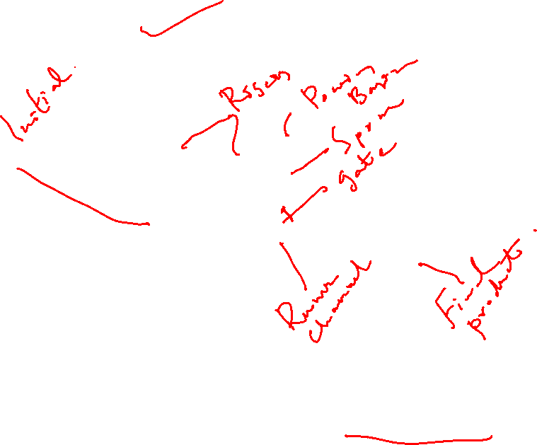
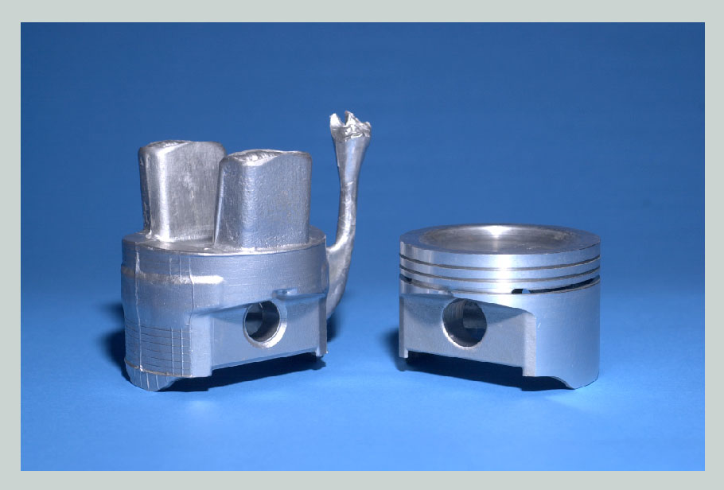
Aluminum Piston
Aluminum piston for an internal combustion engine. (a) As cast; (b) after machining.

Slide 15
Machining Allowance
Metal
Dimension (inch)
Allowance (inch)
Cast iron
Up to 12
12 to 20
20 to 40
0.12
0.20
0.25
Cast steel
Up to 6
6 to 20
20 to 40
0.12
0.25
0.30
Non ferrous
Up to 8
8 to 12
12 to 40
0.09
0.12
0.16

Slide 16

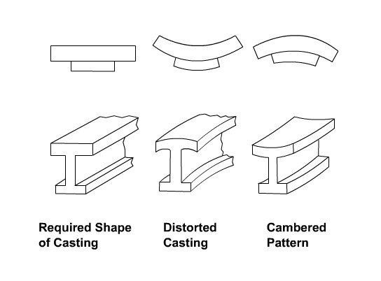
Distortion / Camber allowance

Slide 17
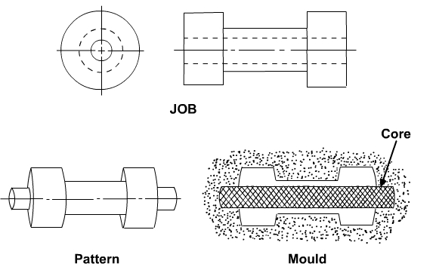
Rapping Allowance
To facilitate easy withdrawal of the pattern, it is
sometimes rapped all around the vertical faces to
slightly enlarge the mold cavity. Hence the original
pattern dimension should be reduced to compensate
for this increase in dimension of the mold cavity.
However it is difficult to quantify this allowance.
Core and Core prints

Slide 18

Classification of Casting Processes
Conventional Molding Processes
Green sand molding
Dry sand molding
Chemical sand molding processes
Shell Molding
Sodium silicate Molding
Permanent Mold Processes
Gravity die casting
Pressure die casting
Special Casting Processes
Investment Casting
Evaporative pattern
Centrifugal casting

Slide 19

Molding Materials and their properties
Mold materials include molding sand, backing sand,
Facing sand, core sand etc. The imp. Properties are:
refractoriness
permeability
green strength
dry strength
hot strength
collapsibility
Molding sand composition
base sand
binder
moisture

Slide 20
Base Sand
Silica sand is most widely used.Also zircon sand,
chromite sand and olivine sand can be used
Binders
clay binders
organic binders
inorganic binders
Most common clay binders are:
Kaolinite /fire clay (Al₂O₃ 2 SiO₂ 2 H₂O) &
Bentonite (Al₂O₃ 4 SiO₂ nH₂O)
Bentonite has higher moisture absorbing power
Moisture required for bonding action of the clay

Slide 21
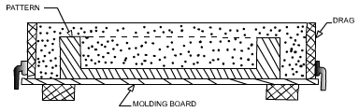
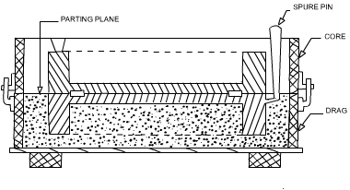
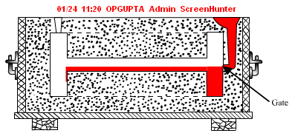
Green Sand Mold making procedure
Dry facing sand sprinkled
on board & pattern & then
Molding sand is packed
Cope half placed over the
Drag half Parting sand
Sprinkled over the drag
& the pattern Sprue pin,
Riser pin placed
Facing sand in the form
of paste applied in the
Mold cavity The mold
is now ready for pouring

Slide 22
Dry Sand molds
To lower gas forming materials in the mold sometimes
Air dried molds are used.
Drying of molds can be of two types:
  skin dried
  complete mold drying
Common methods of drying the mold
  hot air
  gas or oil flame
Skin drying accomplished with the aid of torches
Directed at the mold surface

Slide 23
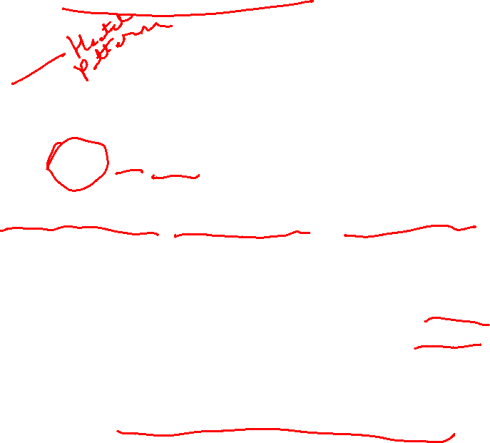
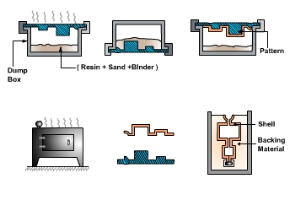
Shell Molding Process
3 to 8% phenolformaldehyde / ureaformaldehyde thermosetting resin
230 to 350º C
Lubricants like zinc/calcium stearate improve flowability

Slide 24
Advantages of Shell Mould Casting
Good surface finish (Ra 1.25 to 3.75 microns)
High dimensional tolerance
Amenable towards automation
Castings weighing upto 450 kgs can be cast by this process
Thin sections (upto 0.25 mm) can be cast by this process
Limitations
Patterns are expensive
Castings weighing more than 450 kgs cannot be made
Highly complicated shapes cannot be made
Applications
Cast iron, Aluminium and copper alloys are cast by this process

Slide 25
Sodium silicate Molding Process
The refractory material is coated with a sodium
Silicate binder. After compaction CO₂ is passed
Through the mold. CO₂ chemically reacts with
Sodium silicate to cure or harden the binder. After
Curing the pattern is withdrawn from the mold
Advantages
good dimensional tolerance because of the
hard rigid mold
good surface finish of the cast products
Limitations
poor shake out and collapsibility
binder hygroscopic causing porosity in castings

Slide 26
Permanent Mold casting / Gravity Die casting
Permanent Mold Materials:
Fine grained grey cast iron
Alloy steels for large volumes and large parts
Graphite for small volume castings of Al & Mg
The die life depends on
the melting temperature of metals and alloys
The molds are coated with refractory to a layer of 8 mm
Materials normally cast in permanent molds
Al. alloys
Mg alloys
Zn alloys
Grey Cast Iron

Slide 27
Advantages of Gravity Die Casting
A fine grained casting with superior mechanical properties
Good surface finish (4 microns)
Good dimensional tolerance
Mass production of castings possible
Limitations
Maximum weight of casting limited to 15 kgs
Complicated shapes cannot be produced
Applications
Automobile pistons, stators, gear blanks, connecting rods etc

Slide 28

Pressure Die Casting
Molten metal enters the die cavity at pressures 70 to 2000 times
the normal atmospheric pressure
Employment of high pressure aids in die casting of
  narrow sections
  complex shapes
  finer surface details of the casting
Die Casting Machines are basically of two types
Cold Chamber die casting
Hot chamber die casting

Slide 29
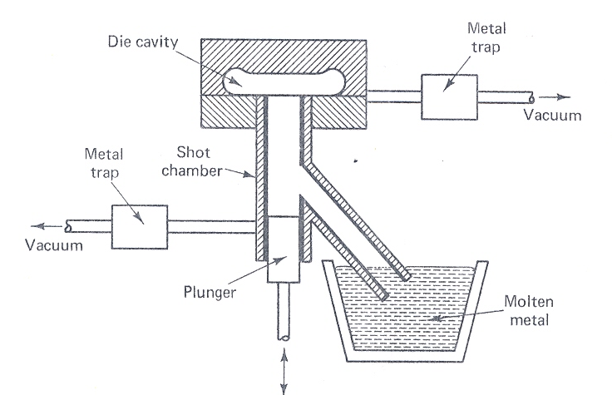
A Cold Chamber Die Casting Method
Vertical Type

Slide 30
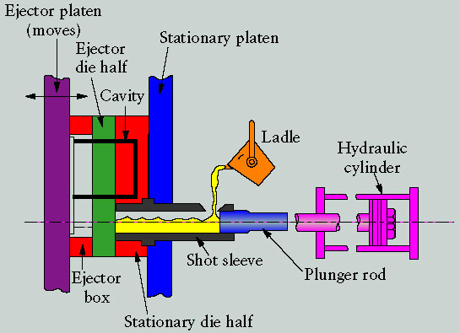
A Cold Chamber Die Casting Method
Horizontal Type

Slide 31
Cold chamber die casting suitable for casting of
Aluminium alloy
Mg alloys
Brass etc
Pressure applied in cold chamber die casting method can be
as high as 2000 atmospheres
Advantages
high temperature metals and alloys can be cast
large parts (weighing around 25 kgs) can be cast
high surface finish ( 1 μm) and dimensional tolerance
better mechanical properties of the casting because of the fine grains
Limitations
large cycle time
metal sometimes looses the superheat and cause defects such as
“cold shut”
dies and the machines are expensive

Slide 32
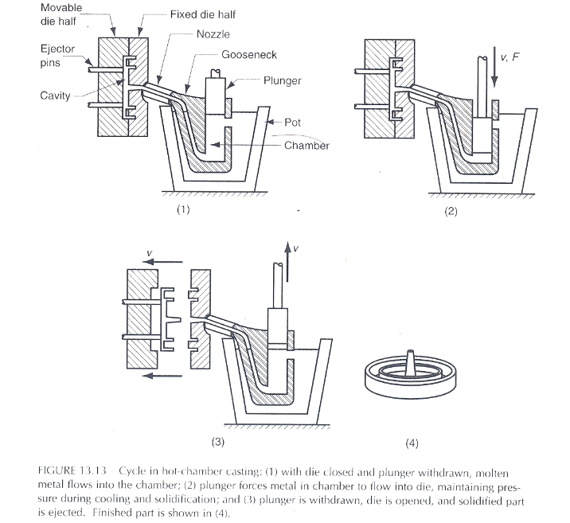

Hot Chamber Die Casting
Die closed and plunger withdrawn
Metal forced
into die cavity at
fixed press.
Plunger
withdrawn
& die opened
Press. 50 to
150 atm

Slide 33
Advantages of Hot Chamber Die Casting
Improved productivity
Superior surface finish
High tolerance
Intricate shapes with thin walls can be easily produced
Limitations
Only low melting alloys (such as Zn, Sn, Pb) are cast
Small castings weighing less than 4.5 kg can be cast

Slide 34
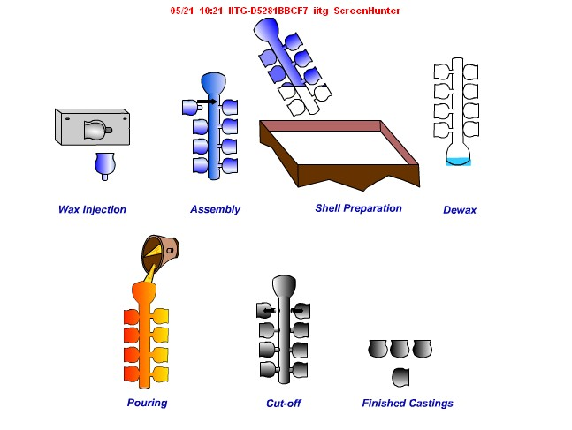

INVEST MENT CASTING

Slide 35
Steps followed in Investment Casting Process
A heat disposable pattern made of wax or plastic is made
A pattern assembly (tree / cluster) is prepared attached to a
central wax sprue
3. Pattern assembly is invested into a ceramic slurry composed of
silica flour suspended in soln. of ethylsilicate. Ceramic shell of
6mm thickness is formed around the wax assembly.
4. The assembly baked in oven to melt out the wax/plastic thereby the
dimensions of mold cavity precisely match those of the product
5. The shell mold is fired at 900 to 1000⁰ C to remove all traces of wax
and also the strength gets enhanced
6. Molten metal is poured when the mold is still hot resulting in a
production of a cluster of castings at a time

Slide 36
Applications of Investment Casting
Intricate shaped objects like jewelry
Cylinder heads
cam shafts
gas turbine blades
Advantages of Investment Casting Process
Complicated and intricate shaped products can be easily cast
High dimensional tolerance achievable
Surface finish is excellent
Additional machining not required as it is a net shape process
All types of metals and alloys can be cast by this process
Limitations
A relatively expensive process
Size of the casting is limited (max. around 5 kg)

Slide 37
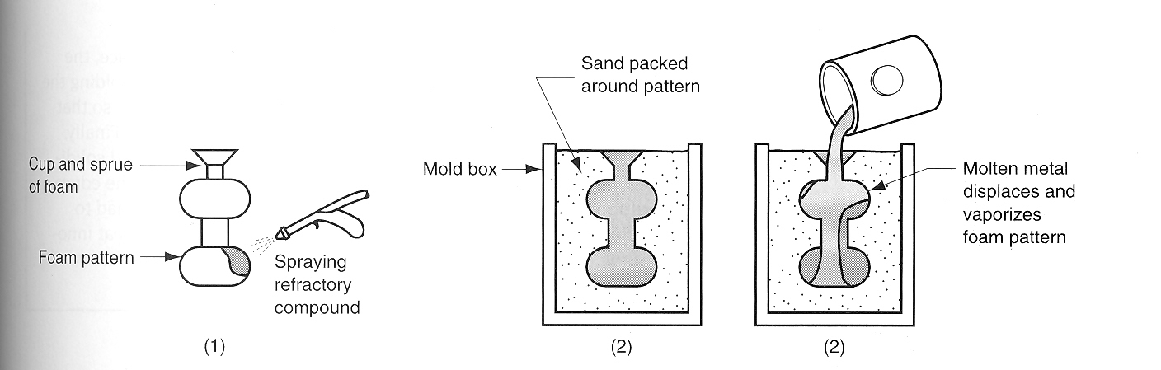
Evaporative Polystyrene Process (EPS) / Lost Foam Process /
Full Mold Process / Evaporative Foam Process
Coating of the polystyrene
Pattern to provide a smoother
casting

Slide 38
Procedural steps in EPS Casting Process
Beads of polystyrene are pre-expanded and introduced into die cavity.
A steam cycle fully expands the beads and help in fusing them together
For complex patterns different pattern sections are assembled and glued together to form a cluster. Pouring cup and sprue are also attached in a similar fashion
The foam pattern cluster is coated with a refractory material
After the coating has dried the pattern assembly is placed in a vented flask and molding sand is compacted around the pattern by using a vibration table to ensure proper and uniform compaction
Molten metal is poured into that portion of the pattern which forms the pouring cup and sprue

Slide 39
Advantages of the EPS Process
Need for pattern withdrawal is eliminated
No binders or other additives are required for the sand which
is reusable
Cores are not required
Shake out of the casting in the unbonded sand is easier
Consideration for draft and parting lines can be ignored
Limitations of the EPS Process
A new pattern is needed for every casting
This process is economic only when mass scale castings are produced
Applications
The EPS process has been applied to mass produce castings of
Automobile engines

Slide 40
Centrifugal Casting
It refers to several casting methods in which the mold is rotated
at moderate to high speed so that the centrifugal force distributes
the molten metal into the mold/die cavity
Centrifugal Castings are of three types
True Centrifugal Casting
Semi centrifugal Casting
Centrifuge Casting

Slide 41
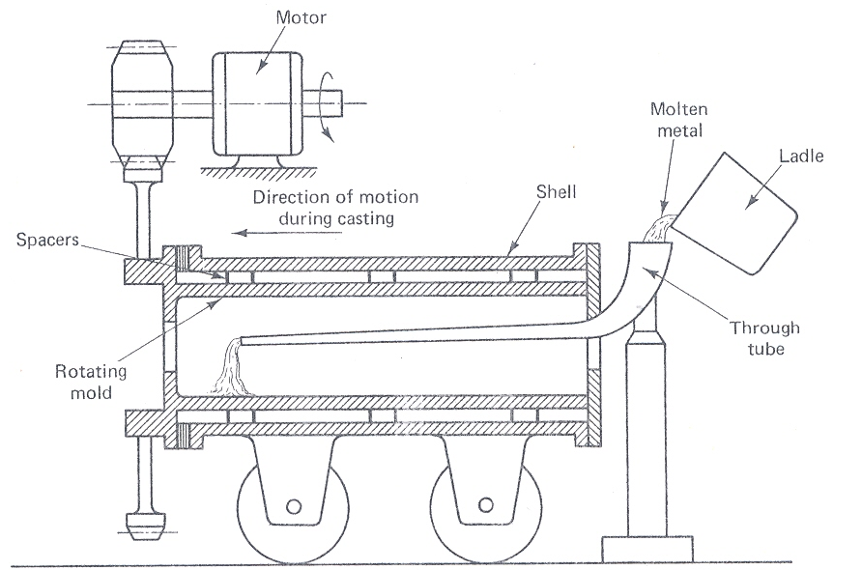
A True Centrifugal Casting Machine

Slide 42
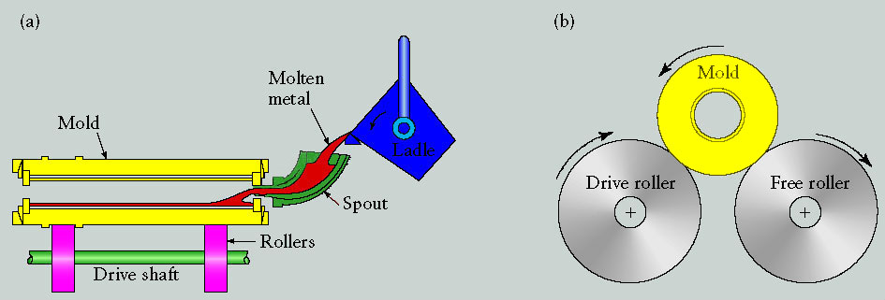
Centrifugal Casting Process
Schematic illustration of the centrifugal casting process. Pipes, cylinder liners, and similarly shaped parts can be cast by this process.

Slide 43
True Centrifugal Casting produces hollow shaped products without
using internal cores
The Centrifugal accelerating force is high almost 70 to 80 times that
of gravity which helps in pushing the molten metal to the walls of the
mold
Outer shape is controlled by the mold contour while the inner shape is
controlled by the amount of the molten metal poured in
There are horizontal as well as vertical axis machines. Only short tubes are
manufacture in the vertical machines
Advantages
Mechanical properties of the castings are better
Directional solidification can be accomplished
Core requirements are eliminated
Gating system is not required

Slide 44
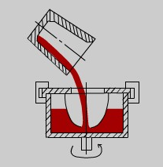
CENTRIFUGAL CASTING
Limitations
VERTICAL TYPE
Axisymmetric shapes and concentric
holes are suitable for CC
Equipment cost is high so suitable
for mass production

Slide 45
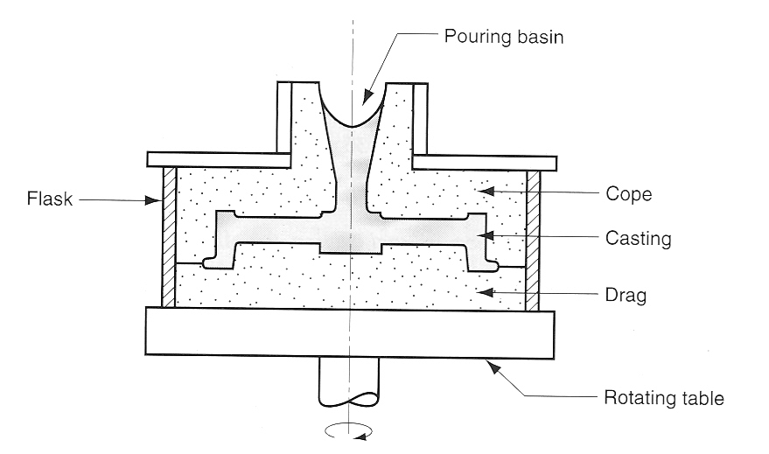
Semi centrifugal casting
Wheels and pulleys
Solid castings are produced
Rotating speed is not very high
Density is high at the outer section than in the inner section
Such casting technique suitable for products undergoing subsequent
machining

Slide 46
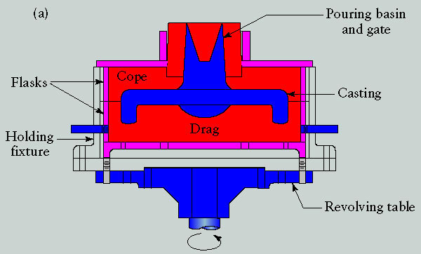
Semicentrifugal Casting Process
(a) Schematic illustration of the semicentrifugal casting process.

Slide 47
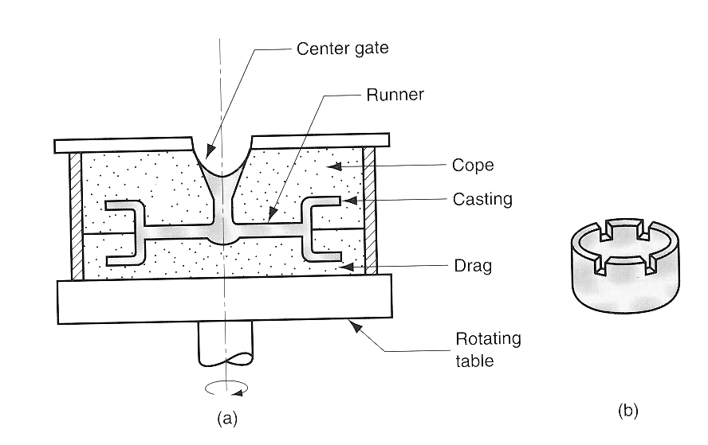
Centrifuging
Centrifuging process can cast products not having axisymmetry
The process is used for smaller parts
Metals cast by centrifuging are aluminium, steels and cast irons

Slide 48
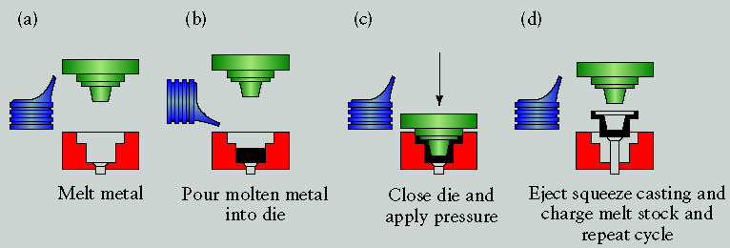
Squeeze-Casting Process
Sequence of operations in the squeeze-casting process. This process combines the advantages of casting and forging.

Slide 49
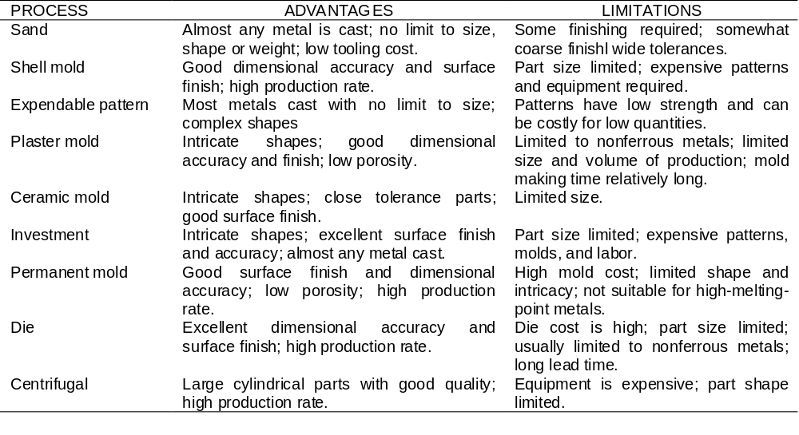
Casting processes, and their advantages and limitations.

Slide 50
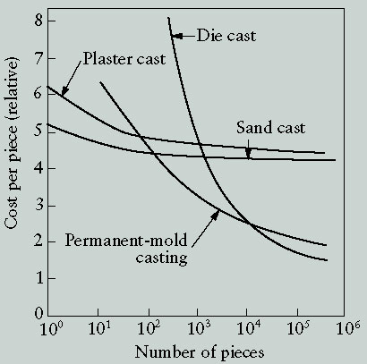
Costs Comparison for Different Casting Processes
Economic comparison of making a part by different casting processes. Note that because of the high cost of equipment, die casting is economical for large production runs. Source: The North American Die Casting Association.

Slide 51
Classification of casting defects
Surface Defects
blow
scar
drop
scab
penetration
Internal Defects
blow/gas holes
porosity
pin holes
inclusions and dross
Visible Defects
rat tail
swell
misrun
cold shut
hot tear
shrinkage
mold shift
core shift

Slide 52
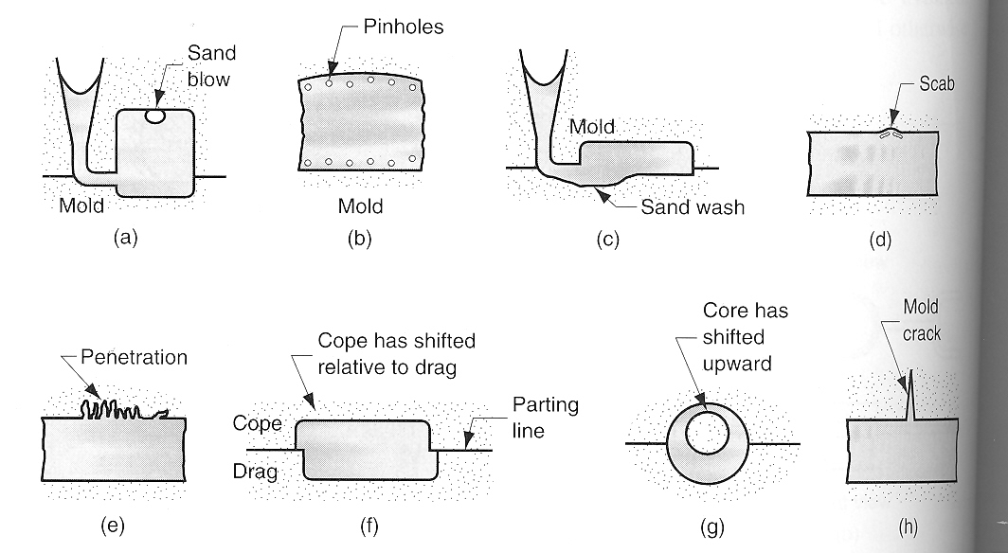
DEFECTS IN CASTINGS
Molding sand too too fine
or heavily rammed
Sand erosion
Low permeability
Poor venting, high moisture
Hydrogen inclusion
Buoyancy of liq. metal
Inadequate packing
High fluidity
Surface and internal defects
Poor mold strength

Slide 53
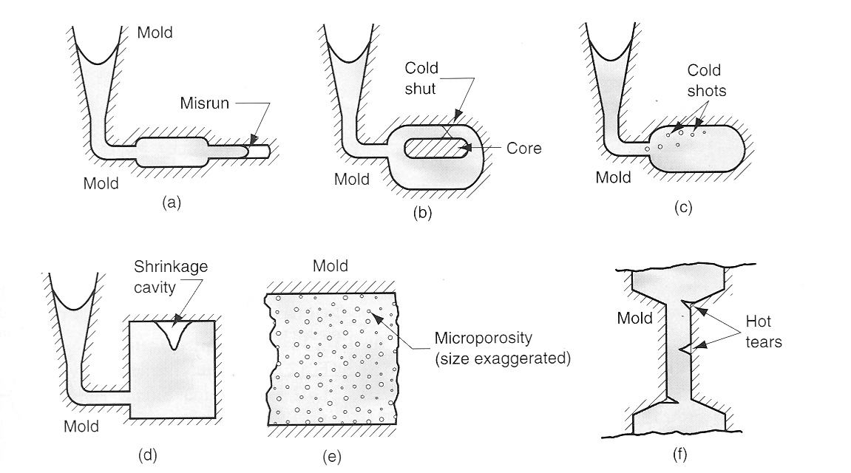
DEFECTS IN CASTINGS
Splattering
during pouring
Insufficient fluidity
Low superheat
Slow pouring rate
Cross section too thin
Visible Defects
Common in alloys
Improper riser design
Poor collapsibility

